Slide 1
Genetics Clinic Evaluation and Support Resources
Farah Ladha, MS, CGC
Certified Genetic Counselor

Slide 2
The Genetic Testing Process

Slide 3
Testing Plan
Payment for Testing
Options:
Sample Collection
Blood draw in clinic
Genetics team and family decide on testing plan
Insurance benefits investigation [1-2 weeks]
Parents provide consent for testing
Saliva or cheek (buccal) swab, can be mailed to family's home
Self-pay (without insurance)
Insurance pre-authorization [1-2 months]
Some labs offer specific tests at no charge
Results
Could take a few weeks to months
Follow-Up
Detailed discussion of results at appointment
Next Steps
Testing at-risk family members
Results can be given via phone or on MyChart
Return to the Genetics Clinic (from every few months to once a year)
Begin referrals and treatment recommendations
May include additional genetic testing
Treatments and recommendations
May include additional genetic testing

Slide 4
Testing in a step-wise approach
Test #3 (if needed)
Research studies
Re-analysis of previous testing
Test #1
Test #2
If negative (normal)
If negative (normal)

Slide 5
Genetic Testing and the Law

Slide 6
Genetic Information Nondiscrimination Act (2008)
Existing federal and state laws that will protect you and your children from discrimination due to genetic testing results
Discuss in more detail with your Genetics provider
https://www.ashg.org/advocacy/gina/

Slide 7
Finding a Genetics Clinic and Provider

Slide 8
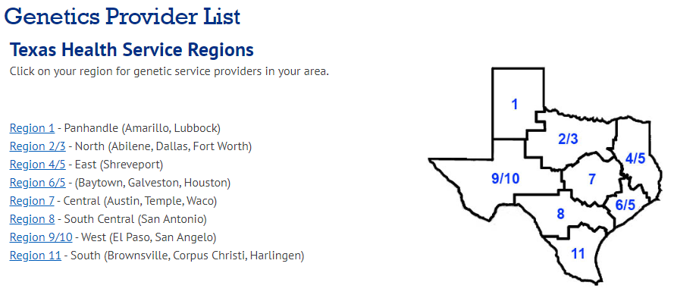
Find a Genetics Clinic in Texas
Texas Department of State Health Services
https://www.dshs.texas.gov/genetics/provider.shtm

Slide 9
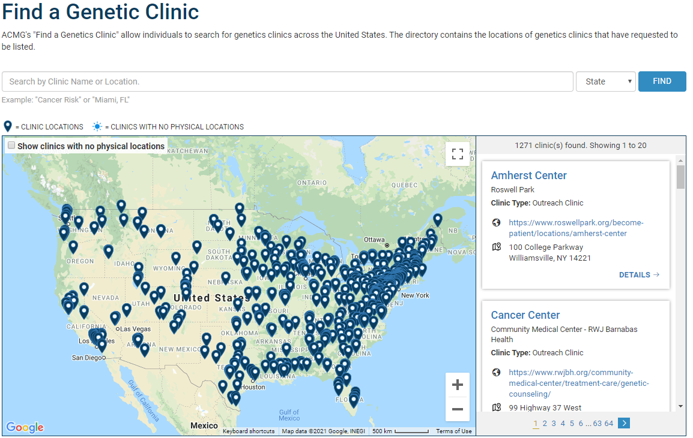
Find a Genetics Clinic in the USA
American College of Medical Genetics and Genomics
https://clinics.acmg.net/

Slide 10
Find a Genetic Counselor
National Society of Genetic Counselors
https://findageneticcounselor.nsgc.org/

Slide 11
Genetics Support and Resources

Slide 12
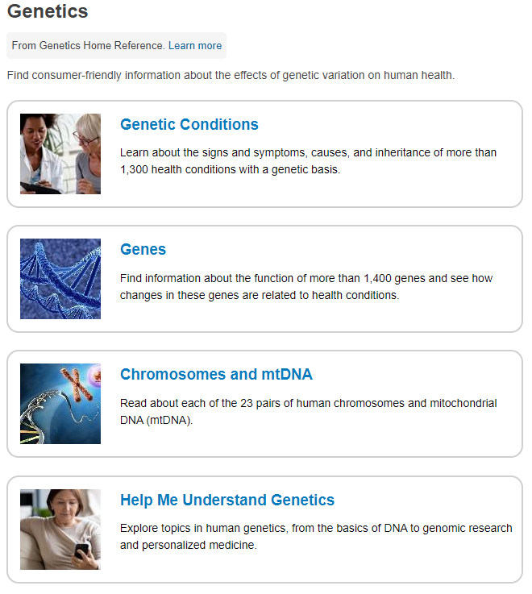
Genetics Home Reference
Now merged with MedlinePlus
Includes information about specific genetic conditions, genes, and FAQs for understanding genetics-related topics
https://medlineplus.gov/genetics/

Slide 13
National Organization for Rare Disorders (NORD)
Patient advocacy organization dedicated to individuals with rare diseases and the organizations that serve them
Patient and caregiver resources
Rare Disease Database – brief introductions for patients and caregivers to specific rare diseases
Rare Disease Video Library – educational videos on specific rare diseases
Patient financial assistance program
Annual Living Rare, Living Stronger Patient & Family Forum
https://rarediseases.org/

Slide 14
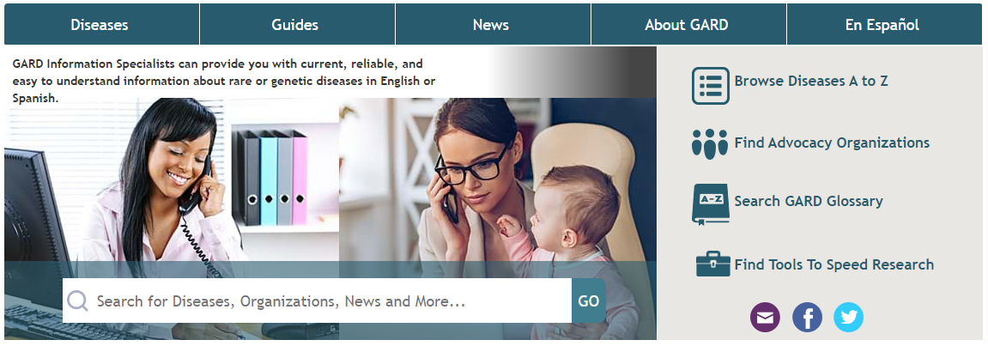
Genetic and Rare Diseases Information Center (GARD)
Provides the public with access to current and easy-to-understand information about rare or genetic diseases in English or Spanish
Maintains a database of rare diseases and relevant information
Guides on genetics-related topics for patients, healthcare professionals, researchers, and teachers/students
https://rarediseases.info.nih.gov/

Slide 15
Global Genes
Provides information, resources, and connections to all communities affected by rare disease
Resource hub and rare diseases list
RARE University
RARE Concierge
RARE Patient Advocacy Summit
https://globalgenes.org/

Slide 16
Unique: Understanding Rare Chromosome and Gene Disorders
Information about rare chromosome disorders and copy number variants for patients and healthcare professionals
Free disorder guides for a variety of specific chromosome and single gene disorders
Little Yellow Book
Practical guides for families
Some guides are translated into several languages
https://rarechromo.org/disorder-guides/

Slide 17
The Chromosome Disorder Outreach
Information about rare chromosome disorders and copy number variants for patients and healthcare professionals
Introduction to Chromosomes guide
Genetic and medical glossary
General informational packets about common chromosome disorders; personalized information packets for members
https://chromodisorder.org/

Slide 18
Genetic Support Foundation
Patient-friendly informational pages about patterns of inheritance, common genetic tests, etc.
https://geneticsupportfoundation.org/genetic-counseling/

Slide 19
Support Groups for Specific Conditions

Slide 20
Down Syndrome
National Down Syndrome Society
Resources with general information and information across the life span
Information about local support organizations (https://www.ndss.org/resources/local-support/)
Down Syndrome Specialty Clinics Database (https://www.ndss.org/resources/healthcare-providers/)
Support groups in several cities in Texas
Down Syndrome Coalition of El Paso
Several programs and educational programs
Website available in Spanish
https://www.dscep.org/

Slide 21
Neurofibromatosis Type 1
Children’s Tumor Foundation
Information for newly diagnosed patients and throughout the lifespan
Search engine for NF clinics and relevant healthcare providers (https://www.ctf.org/understanding-nf/find-a-doctor)
NF Registry (https://www.ctf.org/understanding-nf/nf-registry)
Annual conference in the summer (https://www.ctf.org/get-involved/nf-conference)
Texas Neurofibromatosis Foundation
Information about NF and local support groups
NF family camp and symposium
https://www.ctf.org/
https://www.texasnf.org/

Slide 22
22q11.2 Deletion Syndrome
The 22q Family Foundation
Information about 22q for patients and providers
22q clinic locator (https://22qfamilyfoundation.org/living-with-22q/22q-clinics)
22q family map (https://22qfamilyfoundation.org/living-with-22q/22q-digital-map)
22q Texas, Inc.
Facebook group with local subgroups
https://22qfamilyfoundation.org/
https://www.facebook.com/22qTexas

Slide 23
Other Syndrome-Specific Support Groups
There are an increasing number of online family support groups being created for well-described (and less well-described) genetic syndromes
Google [syndrome name] + Support
Google [gene name] + Support
Search for the syndrome name or gene name on social media
Search Facebook
Search hashtags on Twitter, Instagram, etc. (#noonansyndrome)

Slide 24
Thank you!
Contact information: Farah Ladha, MS, CGC Baylor College of Medicine/Texas Children’s Hospital Phone: 832-822-4317 Email: Faladha@texaschildrens.org

